Slide 1


TRAINING & ASSESSMENT
QUALITY AREA 1
PRESENTED BY
Amy Conrad

Slide 2
HAWKEYE Consultancy

Slide 3

ACKNOWLEDGEMENT OF COUNTRY
We would like to acknowledge the traditional​ custodians of the lands and waterways we are meeting upon today. We pay our respect to all elders past, present and emerging and all Aboriginal and Torres Strait Islander people in today’s session.

Slide 4

LEARNING OBJECTIVES
To understand:
The intent and expectations of Outcome Standards 1.1 to 1.4, and 1.6 to 1.8 within Quality Area 1: Training and Assessment.
Identify the risks to quality and compliance in training delivery, assessment, RPL, credit transfer, and resource management.
Apply practical strategies to align your practices with the principles of assessment and rules of evidence.
Use self-assurance questions to evaluate the effectiveness of your RTO’s systems and processes.
Note: Standard 1.5 – Validation – is covered in a separate validation-specific workshop.

Slide 5
WHY THIS MATTERS
ACHIEVING QUALITY IN RTOS
The 2025 Outcome Standards represent a major shift in how quality and compliance are understood and demonstrated in the VET sector.
Rather than ticking boxes, the focus is now on:
Self-assurance & evidence-based practice.
RTOs are expected to proactively monitor, evaluate, and improve their training, assessment, and support systems.
Quality must be evidenced through your actions, records, and results, not just policies.
What This Means for You:
Greater emphasis on authentic delivery, fit-for-purpose assessment, and transparent decisions
Compliance is continuous, embedded in day-to-day operations.
Ensure high standards are consistently met.
Implement changes based on data and results.
Assess and enhance training methods.
Regularly check training and assessment systems.

Slide 6

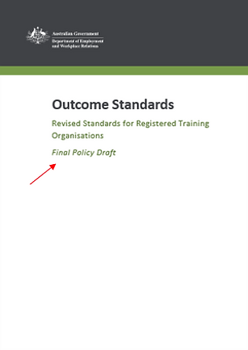
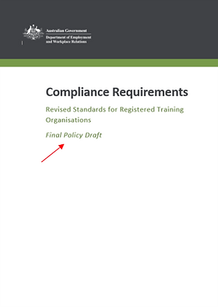
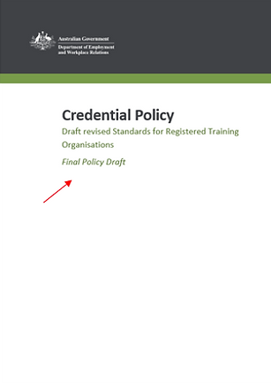
STRUCTURE OF THE REVISED VET QUALITY FRAMEWORK
Department of Employment and Workplace Relations (DEWR) published:
  Outcome Standards
  Credential Policy
  Compliance Requirements, including:
                Information and Transparency
                Integrity of Nationally Recognised Training Products
                Accountability
                Australian Qualifications Framework—which is the national policy for regulated qualifications in Australian education and training.
                Schedule 1: Data Provision Requirements 2020—which sets out the requirement for providers to supply ASQA with data upon request, and to submit quality indicator data annually
                Schedule 2 – Nationally Recognised Training Logo Conditions of Use Policy
                Financial Viability Risk Assessment Requirements 2021—which relate to training organisations' ability to meet financial viability requirements
  Sourced: https://www.dewr.gov.au/standards-for-rtos

Slide 7
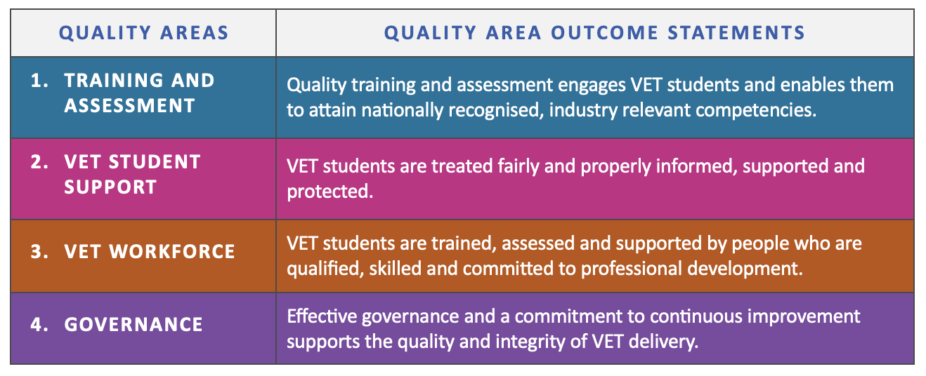
THE OUTCOME STANDARDS –
THE 4 QUALITY AREAS
1. Training and assessment
2. Learner support
3. VET Workforce
4. Governance

Slide 8
ASQA’S REGULATORY GUIDELINES TOPICS
1.
10.
19.
Training.
VET Workforce Management.
Notification of Material Changes.
Assessment.
Trainer and Assessor Competencies.
Third Party Arrangements.
2.
11.
20.
3.
12.
21.
Credit Transfer.
Leadership and Accountability.
Prepaid fee Protection Measures.
4.
13.
22.
Facilities, Resources and Equipment.
Risk Management.
Public Liability Issuance.
5.
14.
23.
Information.
Continuous Improvement.
Compliance with Laws.
Training Support.
Information Management.
Fit and Proper Person Requirements.
6.
15.
24.
7.
16.
25.
Diversity and Inclusion.
Marketing and Advertising.
Credential Policy.
Wellbeing.
Integrity of Nationally Recognised Training.
8.
17.
9.
18.
Feedback, Complaints and Appeals.
Annual Declaration of Compliance.

Slide 9
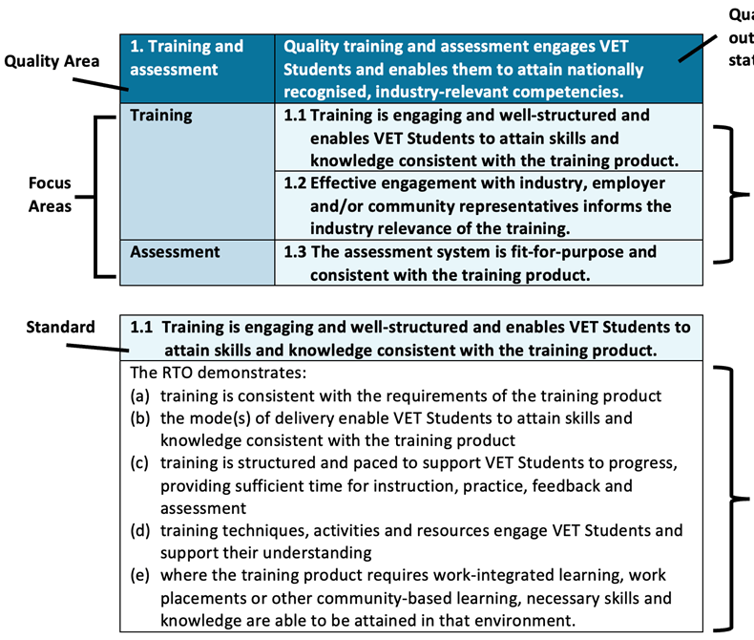

STRUCTURE OF THE OUTCOME STANDARDS

Slide 10
KEY FOCUS AREAS OF QUALITY AREA 1
ENGAGING TRAINING
Ensures training is interactive and effective for skill and knowledge acquisition.
ADEQUATE RESOURCES
Provides sufficient and safe facilities and equipment.
INDUSTRY RELEVANCE
Aligns training with current industry practices and needs.
CREDIT TRANSFER
Facilitates the transfer of credits for equivalent training.
FIT-FOR-PURPOSE ASSESSMENT
Ensures assessment tools are appropriate and consistent.
QUALITY
AREA 1
RECOGNITION OF PRIOR LEARNING
Acknowledges and credits prior skills and knowledge.
FAIR ASSESSMENT
Guarantees fair and unbiased assessment processes.
QUALITY ASSURANCE
Maintains high standards through regular validation.

Slide 11
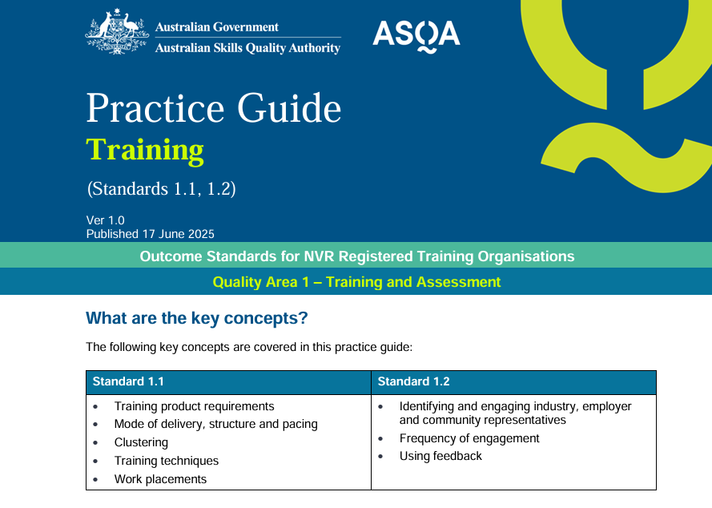
TRAINING
(STANDARDS
1.1 – 1.2)

Slide 12
STANDARD 1.1
Training is engaging, well-structured and enables VET students to attain skills and knowledge consistent with the training product.
TRAINING IS ENGAGING
ENJOYABLE
LEARNING
Makes learning enjoyable and effective for participants.
WHAT THIS MEANS FOR YOU:
Training must align with the training product and AQF.
Delivery modes must enable skill acquisition (face-to-face, online, blended).
Pacing and structure should suit student cohorts.
Activities and resources must support student engagement.
Ensure placements provide genuine skill-building opportunities.
ENHANCED
RETENTION
Improves retention through dynamic and enjoyable learning.
INTERACTIVE ENVIRONMENT
Fosters active participation and skill application.
ATTENTION CAPTURE
Captures participants’ attention to enhance learning engagement.

Slide 13

STANDARD 1.1
Training is engaging, well-structured and enables VET students to attain skills and knowledge consistent with the training product.
TIPS:
Evidencing how your chosen mode of delivery (e.g. face-to-face, online, workplace, traineeship, blended methods, etc) is engaging and appropriate for the skills and knowledge being delivered and has been considered against VET student needs.
Providing students with sufficient opportunity to reflect on and absorb the knowledge, apply feedback, and practice their skills in different contexts/environments before they are assessed.
When delivering similar or complementary units at the same time and having decided upon ‘clustering’, you have documented your rationale before proceeding.

Slide 14
STANDARD 1.2
Engagement with industry, employer and community representatives effectively informs the industry relevance of training offered by the NVR registered training organisation.
COMMUNITY
IMPACT
STUDENT
BENEFITS
INDUSTRY
COLLABORATION
WHAT THIS MEANS FOR YOU:
Actively consult industry, employer, and community reps.
Use their input to shape training strategies and electives.
Training must reflect current industry practice.
Engage regularly and meaningfully – not just at validation.
COMMIUNITY
REPRESENTATION
EMPLOYER
ENGAGEMENT
ENHANCING EDUCATION THROUGH STAKEHOLDER ENGAGEMENT

Slide 15
STANDARD 1.2
Engagement with industry, employer and community representatives effectively informs the industry relevance of training offered by the NVR registered training organisation.
TIPS:
Showing how you identify and routinely review the industry, employer and/or community representatives you engage with about your services.
Demonstrating how your engagement with these representatives generates meaningful advice and feedback on, for example, the type and complexity of training you deliver.
Demonstrating how training delivery is informed and continuously improved by direct and ongoing industry engagement – for example, in response to industry innovation. You can demonstrate how this informs your approach to aspects such as verifying foundational skills and training product entry requirements.

Slide 16
STANDARDS 1.1 & 1.2
COMMON PITFALLS:
Assuming all students share the same skills, experience, and learning preferences.
Designing training without considering the unique needs of the student cohort, learning environment, and training product requirements.
Accelerating delivery without allowing adequate time for practise, skill development and application.
Engaging with industry or stakeholders in a tokenistic way (e.g. one-off sign-offs).
Using outdated or non-contextualised resources.
Overlooking feedback when refining training and assessment design.

Slide 17
SELF ASSURANCE QUESTIONS
TRAINING
How do we ensure trainers are appropriately skilled, qualified, and resourced to deliver effective, engaging training?
How is training adjusted to meet the needs of different student cohorts?
How do we ensure our training design aligns with packaging rules and AQF requirements?
What evidence confirms that our mode of delivery is appropriate for the skills and knowledge being taught?
How is pacing and structure tailored to suit student needs and course complexity?
How do we evaluate the effectiveness of training activities and resources?
Are work placements meaningfully integrated and supporting the development of required skills?
How frequently do we seek advice and feedback from industry or community representatives, and how is this documented?
How do we ensure this engagement is ongoing and genuinely informs our practices?

Slide 18
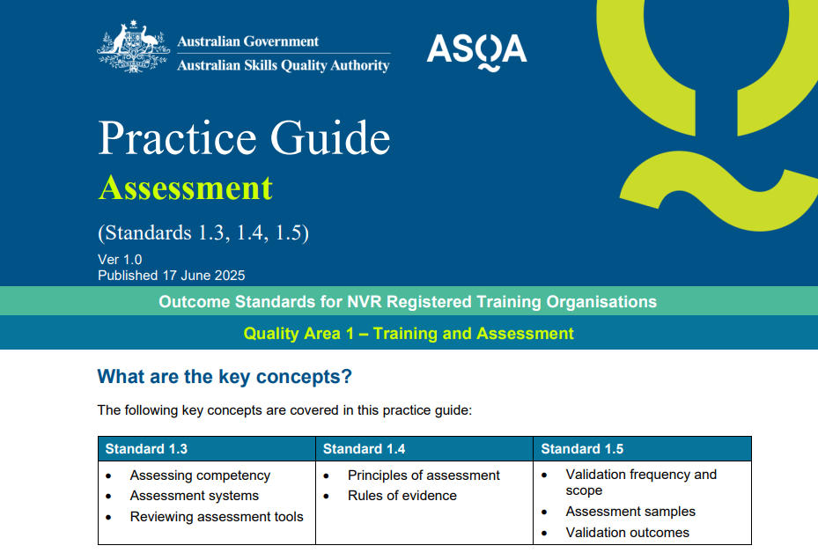
ASSESSMENT
(STANDARDS
1.3 – 1.5)

Slide 19
STANDARD 1.3
The assessment system is fit-for-purpose and consistent with the training product.
WHAT THIS MEANS FOR YOU:
Systems must align with training product units, elements, and criteria.
Review tools prior to use – involve industry and assessors.
Balance theory with practical assessments.
Contextualise tools for your learners and delivery mode.
Avoid over-reliance on generic tools or unverified third-party products.

Slide 20
STANDARD 1.3
The assessment system is fit-for-purpose and consistent with the training product.
TIPS:
Keeping record of what changes and improvements have been made following a review of assessment tools.
Demonstrating how off-the-shelf tools are tailored into the RTO's assessment system.
Developing appropriate guidance for how the integrity of Assessment Judgement is maintained when there are variations to the duration of training.

Slide 21
STANDARD 1.4
The assessment system ensures assessment is conducted in a way that is fair and appropriate and enables accurate assessment judgement of VET student competency.
WHAT THIS MEANS FOR YOU:
Apply fairness, flexibility, validity, and reliability in all assessments.
Meet rules of evidence: validity, sufficiency, authenticity, currency.
Consider learner needs and enable reassessment when appropriate.
Assessment must reflect real-world, workplace application.

Slide 22
STANDARD 1.4
The assessment system ensures assessment is conducted in a way that is fair and appropriate and enables accurate assessment judgement of VET student competency.
TIPS:
Providing clear guidance to both the assessor and the student on what each assessment task is. i.e. what is being assessed, context and conditions of assessment, how and when assessment will occur.
When making reasonable adjustments and/or individualising assessment tasks to take into account a student's demonstrated competence, it is documented how the integrity of the training product is preserved.
Using effective plagiarism and/or AI detection tools as art of the assessment judgement process.

Slide 23
STANDARDS 1.3 & 1.4
COMMON PITFALLS:
Conducting group assessments without assessing individual competency.
Inadequate checks to verify authenticity of student work (e.g. AI-generated content).
Making excessive adjustments that undermine the integrity of the training product.
Using generic assessment tools without contextualising them to the cohort, delivery mode, or training product.
Relying on generic templates or checklists to review assessment tools, rather than conducting a rigorous evaluation.
Failing to review mandated assessment tools for licensed outcomes to ensure alignment with the principles of assessment and rules of evidence.

Slide 24
SELF ASSURANCE QUESTIONS
ASSESSMENT
Are our assessment tools aligned to the training product, mapped to unit requirements, and validated for rigour?
Do the tools reflect realistic workplace tasks and contexts relevant to the student cohort and industry?
Are the tools inclusive and adaptable, allowing for reasonable adjustments without compromising the integrity of the training product?
Have off-the-shelf or templated tools been appropriately contextualised for our delivery mode, cohort, and industry requirements?
How do we review and monitor the assessment tools and system for effectiveness, quality, and consistency?
Are students able to demonstrate and apply competence in a range of relevant practical contexts?
How do we ensure the authenticity of student evidence?
Are assessment decisions being made consistently across all assessors?
Is our student appeals process clear, timely, and accessible?

Slide 25
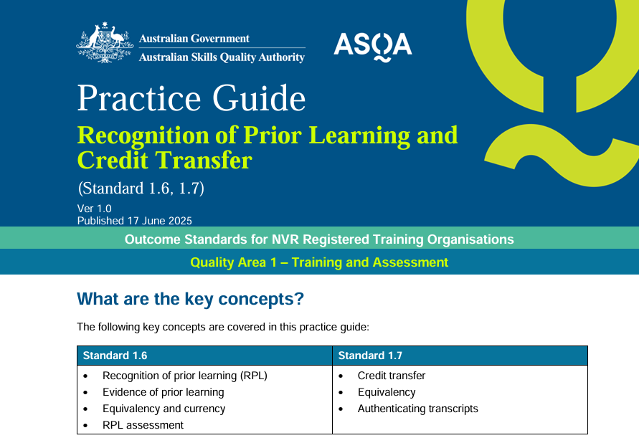
RPL & CT
(STANDARDS
1.6 – 1.7)

Slide 26
STANDARD 1.6
VET students with prior skills, knowledge and competencies are supported to seek recognition of prior learning to progress through the relevant training product.
WHAT THIS MEANS FOR YOU:
Offer and promote RPL where suitable.
RPL must be fair, rigorous, and consistent with the assessment system.
Document decisions thoroughly.
RPL assessors must meet trainer/assessor requirements.

Slide 27
STANDARD 1.6
VET students with prior skills, knowledge and competencies are supported to seek recognition of prior learning to progress through the relevant training product.
TIPS:
Demonstrate how your RPL policies, processes and tools are designed and applied with the same rigour as your assessment system, including that they ensure currency of evidence provided by the VET student.
If third-parties are involved, the RTO's practices rigorous validation of their RPL practices and processed and students know the extent of the third-party's involvement in assessment.
Demonstrating how you work with VET students in relation to the amount of gap training required, how that training will be delivered and any costs associated with it.

Slide 28
STANDARD 1.7
VET students who have completed an equivalent training product are supported to obtain a credit transfer.
WHAT THIS MEANS FOR YOU:
Clearly communicate the credit transfer policy before enrolment.
Base credit decisions on authenticated AQF documents or transcripts.
Where credit is denied, provide alternatives (e.g. RPL) and reasoning.

Slide 29
STANDARD 1.7
VET students who have completed an equivalent training product are supported to obtain a credit transfer.
TIPS:
Where you do not grant credit transfer, because the unit of competency is not deemed equivalent, you provide students with an appropriate alternative pathway, such as RPL.
Authenticating AQF certification documentation provided by students (including authenticated VET transcripts) in support of credit transfer requests by directly accessing the USI transcript service or by contacting the issuing organisation to verify authenticity.
Equivalence is clearly evidenced before applying credit.

Slide 30
STANDARDS 1.6 & 1.7
COMMON PITFALLS:
Not explaining why credit transfer was refused.
Failing to check document authenticity (e.g. USI portal).
Issuing qualifications wholly via credit/RPL without adequate assurance
RPL is listed on ASQA Risk Priorities for 2024-25.
Offering RPL as an “easy” or “fast” pathway.
Outsourcing to unqualified third parties.
Not verifying evidence authenticity.
Failing to assess for gaps or provide bridging training.

Slide 31
SELF ASSURANCE QUESTIONS
CREDIT TRANSFER & RPL
How do we ensure students are informed about RPL early in their engagement?
Are RPL assessments conducted with the same rigour and fairness as other assessments?
Do we verify the authenticity and currency of RPL evidence?
Are RPL assessors appropriately qualified and trained?
How do we handle RPL gaps, and how is gap training delivered and documented?
Do we provide clear information about credit transfer prior to enrolment?
How do we authenticate AQF documentation or transcripts provided by students?
What is our process if credit is not applied, and is the rationale documented and shared with the student?
Do we provide alternatives like RPL where credit isn’t possible?
How do we prevent issuing a qualification solely through credit transfer without sufficient assurance?

Slide 32
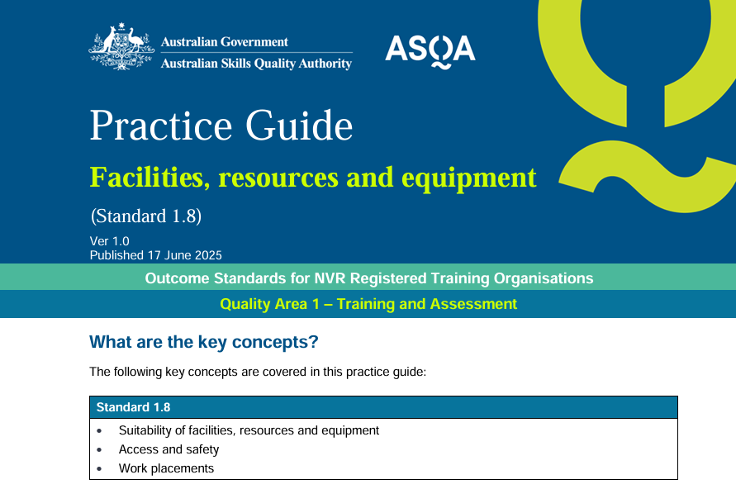
FACILITIES, RESOURCES & EQUIPMENT
(STANDARD
1.8)

Slide 33
STANDARD 1.8
Facilities, resources and equipment for each training product are fit-for-purpose, safe, accessible and sufficient.
WHAT THIS MEANS FOR YOU:
Training spaces and tools must be safe, accessible, and relevant.
Include third-party settings (e.g. placement sites) in risk checks.
Maintain equipment; update with industry relevance.
Ensure equitable access for all students, including online learners.

Slide 34
STANDARD 1.8
Facilities, resources and equipment for each training product are fit-for-purpose, safe, accessible and sufficient.
TIPS:
Having systems in place to monitor and assure the ongoing suitability and safety of facilities, resources and equipment, including where third parties provide these.
An active commitment to work health and safety in your training environment(s).
Demonstrating how you approach the design and delivery of online training and assessment to ensure students can adequately demonstrate the required skills via virtual supervision or observation.

Slide 35
STANDARD 1.8
Facilities, resources and equipment for each training product are fit-for-purpose, safe, accessible and sufficient.
COMMON PITFALLS:
Over-enrolling without adequate facilities/resources.
Outdated or non-compliant equipment.
Poorly managed work placements or WHS gaps.
Relying too heavily on simulated environments without contextual realism.

Slide 36
SELF ASSURANCE QUESTIONS
FACILITIES, RESOURCES & EQUIPMENT
Do our facilities and equipment meet the needs of each training product?
How often do we review and maintain our equipment, including those supplied by third parties?
How do we ensure equitable access to facilities, including online environments?
Are risks identified and managed for placements, community-based learning, or simulated environments?
Do students have clear information on equipment requirements and associated costs?

Slide 37
KNOWN RISKS TO QUALITY AREA 1
TRAINING
One-Size-Fits-All.
Accelerated Delivery.
Industry Validation.
Industry Engagement.
Placement Monitoring.
FACILITIES, RESOURCES AND EQUIPMENT
Over-Enrolment.
Outdated Equipment.
Accessibility Challenges.
WHS Standards.
Misaligned Resources.
EDUCATIONAL QUALITY IMPROVEMENT
ASSESSMENT
Generic Tools.
Compromised Skills.
Group Assessments.
Placement Assessments.
Academic Integrity.
Post-Cohort Review.

Slide 38
WHY THIS MATTERS
Every role within an RTO is interconnected, forming a cohesive ecosystem that directly impacts the student journey. From recruitment and enrolment to training, assessment, and completion, each function is interdependent, impacting the overall quality and compliance with the Outcome Standards for NVR RTOs 2025.
TRAINING AND ASSESSMENT
The core educational process where students gain knowledge and skills before evaluating student learning and ensuring competency.
COMPLETION
The final stage where students successfully finish their programs.
MARKETING, RECRUITMENT AND ENROLMENT
The initial phase of attracting and enrolling students into the RTO.
GOVERNANCE
The benchmark for quality and compliance in RTO operations.
SUPPORT AND PROGRESSION
Providing support needs and ensuring suitable progression throughout the student learning journey.

Slide 39
PRACTICAL IMPLICATIONS
Training and Assessment are the core services of any VET Provider. A decline in the quality of training and assessment services can directly impact student experience and eventually Provider reputation.
Training and Assessment tools and systems if not suitably maintained, can present a risk to a Provider’s registration status. Provider’s should be conducting monitoring, review and implementation, as part of their systems, and not in response to audit events.
There are serious workplace health and safety considerations to be comprehensively assessed by Providers to prevent damage or injury to students and staff.

Slide 40
SUMMARY AND KEY TAKEAWAYS
1
2
3
Outcome Standards are student- and industry-focused.
Self-assurance and ongoing monitoring are critical.
Ensure transparency, documentation, and quality assurance at every stage.

Slide 41
RESOURCES
National Vocational Education and Training Regulator Act 2011
National Vocational Education and Training Regulator (Outcome Standards for Registered Training Organisations) Instrument 2025
Credential Policy
Practice Guide - Training
Practice Guide – Assessment
Practice Guide – Recognition of Prior Learning and Credit Transfer
Practice Guide – Facilities, resources and equipment
Practice Guide – Credential Policy

Slide 42
QUESTIONS? LET’S CHAT!
THANK YOU
CONNECT WITH US
(07) 2113 3870​
hawkeyeconsultancy.com.au​
info@hawkeyeconsultancy.com.au

