Slide 1


GOVERNANCE
QUALITY AREA 4
HAWKEYE ACADEMY
PRESENTED BY
Michelle Kawale (junior consultant)

Slide 2

ACKNOWLEDGEMENT OF COUNTRY
We would like to acknowledge the traditional​ custodians of the lands and waterways we are meeting upon today. We pay our respect to all elders, present and emerging and all Aboriginal and Torres Strait Islander people in today’s session.

Slide 3

LEARNING OBJECTIVES
Understanding:
The function and elements of governance.
Who the ‘governing persons’, ’executive officers’ and ‘high managerial agents’ are within an RTO.
The difference between Fit and Proper Person and Suitable Persons.
The mechanisms that support an RTOs demonstration of leadership and accountability, risk management and continuous improvement.
The positive effect of roles and responsibilities at each level of the organisation and stakeholder relationships.

Slide 4
WHY THIS MATTERS
The Outcome Standards 2025 identifies Governance as a quality area that must be maintained to the same vigour as training and assessment, student support and the VET workforce.
Governance is the key driving force to the establishment, maintenance, and notably even the ceasing of a VET Provider. The goals and strategies that are set, and key individuals who are appointed, at the beginning of a VET Provider will determine much of the nature of progression that occurs.
If the Governance of a VET Provider, made up of the ‘governing persons’ and supporting systems, is not built to demonstrate genuine leadership and accountability, it may reasonably follow that the Provider is not set up to demonstrate genuine training and assessment services.

Slide 5

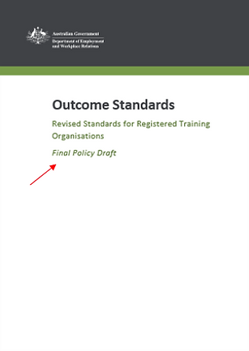
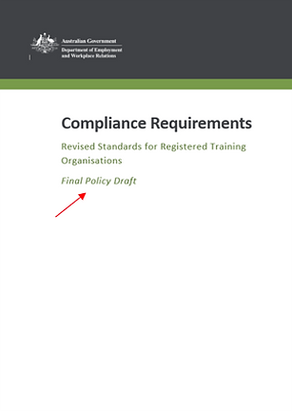
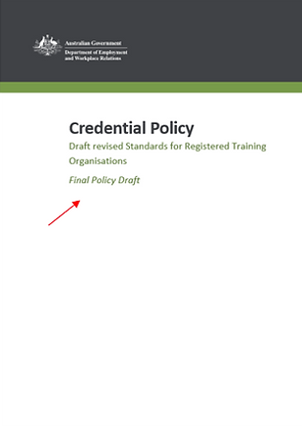
STRUCTURE OF THE REVISED VET QUALITY FRAMEWORK
Department of Employment and Workplace Relations (DEWR) published:
  Outcome Standards
  Credential Policy
  Compliance Requirements, including:
                Information and Transparency
                Integrity of Nationally Recognised Training Products
                Accountability
                Schedule 1 – Fit and Proper Person Requirements
                Schedule 2 – Nationally Recognised Training Logo Conditions of Use Policy
              Data Provision Requirements 2020—which sets out the requirement for providers to supply ASQA with data upon request, and to submit quality indicator data annually
              Financial Viability Risk Assessment Requirements 2021—which relate to training organisations' ability to meet financial viability requirements
              Australian Qualifications Framework—which is the national policy for regulated qualifications in Australian education and training
  Sourced: https://www.dewr.gov.au/standards-for-rtos

Slide 6
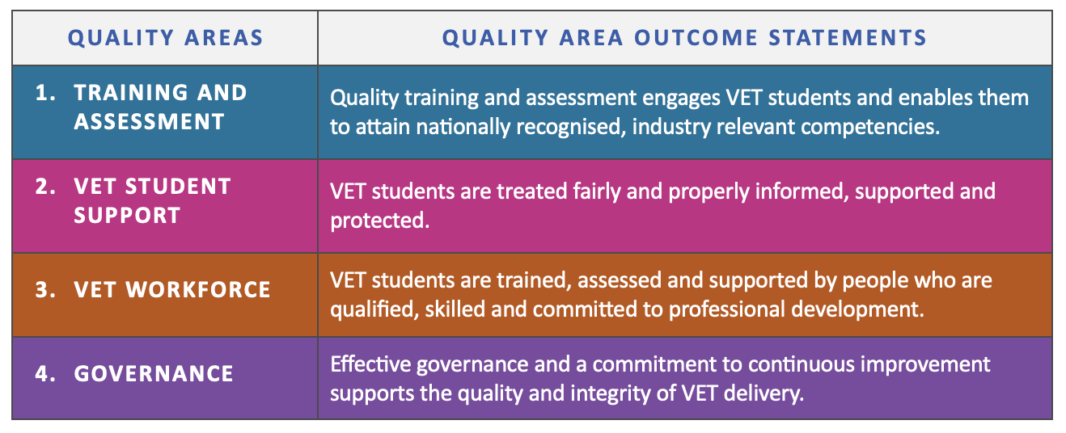
THE OUTCOME STANDARDS –
THE 4 QUALITY AREAS
4.1 INTEGRITY AND ACCOUNTABILITY
4.2 ROLES AND RESONSIBILITES
4.3 RISK MANAGEMENT
4.4 CONTINUOUS IMPROVEMENT

Slide 7
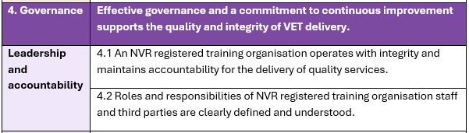
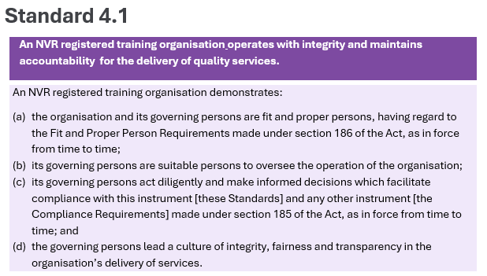
STRUCTURE OF THE OUTCOME STANDARDS
Quality Area
Quality Area Outcome Statement
Focus Area
Outcome Standards
Outcome Standard
Performance Indicators

Slide 8
WHAT IS GOVERNANCE?
“Governance encompasses the system by which an organisation is controlled and operates, and the mechanisms by which it, and its people, are held to account. Ethics, risk management, compliance and administration are all elements of governance.”
- Governance Institute of Australia
FOCUS AREAS
LEADERSHIP
AND ACCOUNTABILITY
RISK
MANAGEMENT
CONTINUOUS
IMPROVEMENT

Slide 9
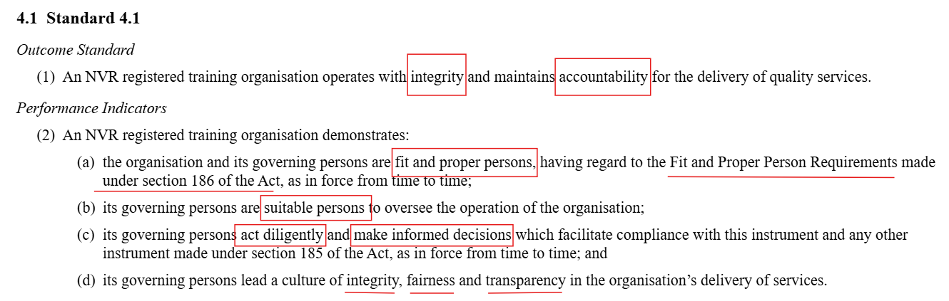
LEADERSHIP AND ACCOUNTABILITY

Slide 10
WHO IS A GOVERNING PERSON?
Governing person means any person responsible for overseeing, directing, or exercising a degree of control or influence over the management or operation of an NVR registered training organisation, including executive officers and high managerial agents. (Outcome Standards for RTOs 2025)
Executive officer means:
a person, by whatever name called and whether or not a director of the organisation, who is concerned in, or takes part in, the management of the organisation; or
if a body corporate:
a person who, … owns 15% or more of the organisation; or
a person who, … is entitled to receive 15% or more of dividends paid by the organisation;
High managerial agent means an employee or agent of the organisation with duties of such responsibility that his or her conduct may fairly be assumed to represent the organisation in relation to the business of providing courses. (National Vocational Education and Training Regulator Act 2011)

Slide 11
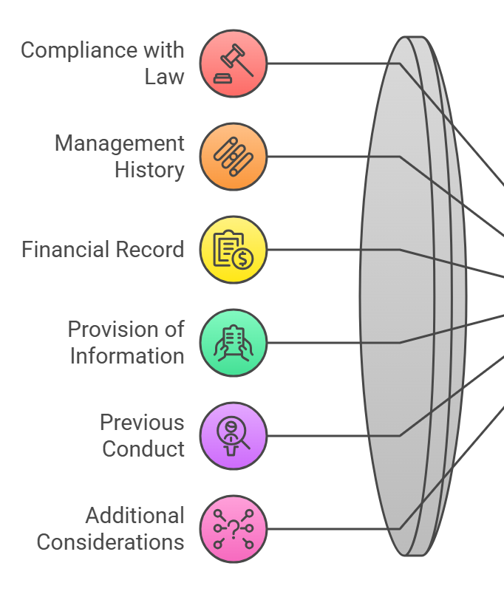

FIT AND PROPER PERSON
Compliance Standards for NVR Registered Training Organisations and Fit and Proper Person Requirements Instrument 2025
Schedule 2

Slide 12
SUITABLE PERSONS
Different from Fit and Proper Person (general – being a person in industry).
Suitable Person is an assessment of the person, against requirements specific to the organisation and the role within the organisation.
Requires the RTO to have a comprehensive job description (job title, function of the role, what responsibilities the role is directly or indirectly accountable for, what the qualifications, experience and skills are required) and organisational chart.
Requires the person to provide a CV that satisfies the job description.
It is in the interest of RTOs to be intentional about the persons they place in governing positions as their control can either contribute to the improvement, stabilisation or deterioration in quality of the RTO and/or the industry they sit in.

Slide 13
INTEGRITY, FAIRNESS AND TRANSPARENCY
QUALITY GOVERNANCE CULTURE
How can an RTO, in their leadership and accountability, demonstrate:
Integrity – maintaining detailed and accurate Meeting Minutes (Template, Procedure and Register) and identifying the principles by which the organisation measures its decisions against
Fairness – when making decisions, governing persons should show proper consideration of all persons (staff, students, community, etc) that may be impacted by the decision, collated through means of invitation for input (Feedback), drawing from existing data, and presented through internal reports or other publications.
Transparency – relevant stakeholders, particularly staff and students should be promptly and regularly informed, whether through organizational emails, social media posts or print methods. Any information disseminated must be true and accurate.
INTEGRITY
The quality of being honest and having strong moral principles.
TRANSPARENCY
Open and clear communication in all activities.
STUDENTS & SERVICES
FAIRNESS
Treating people equally and justly.

Slide 14
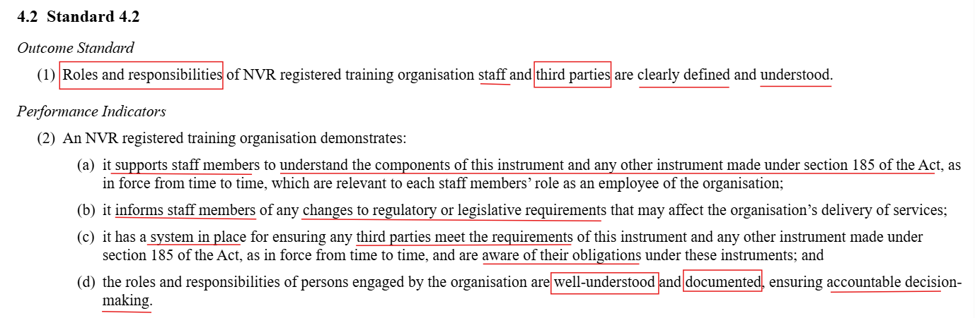
LEADERSHIP AND ACCOUNTABILITY

Slide 15
ROLES AND RESPONSIBILITIES
Now that governing person a clear on who they are in the organisation, they must be able to communicate to everyone else, who are subject to their decisions (through policies and procedures).
Requires that there be a recognised system to effectively communicate to staff. There must be record of the contents of the communication, who the communication was provided to, and acknowledgement of having received and understood the information. E.g. if communication was done through a meeting, the Minutes of the Meeting, when sent out, should require attendees to provide further feedback (questions or concerns) or acknowledgement and comments.
Requires that the RTO know who is responsible for monitoring updates in legislation or industry, and who is responsible for implementing the communication of these changes. The communication must have sufficient content to not only give information, but make sure that it is understood.
Requires third party agreements to be clear and comprehensive in its contents of what the RTOs expectations are of it – the scope, the limitations, the full communication of the Outcome Standards, as applicable to third parties, etc. Third parties should be informed if the provider’s practices and expectations change, particularly where there are regulatory or legislative changes.

Slide 16
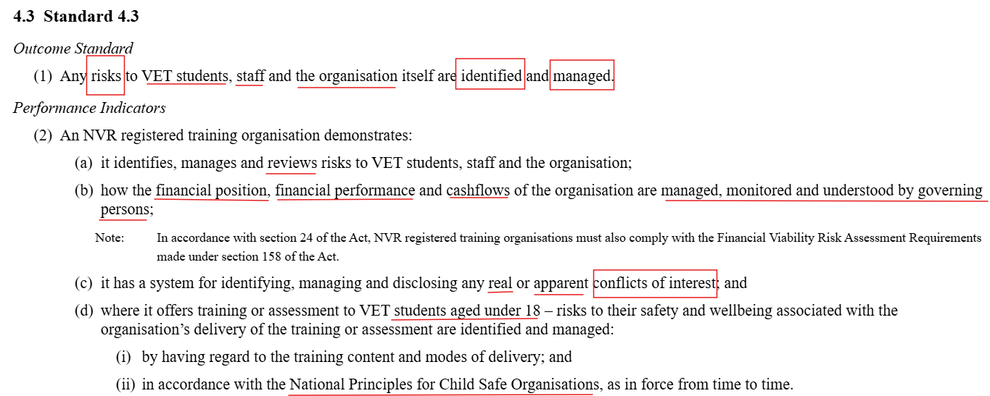
RISK MANAGEMENT

Slide 17
RISK AREAS
RISK AREAS
Finances (position, performance, cashflow).
National Vocational Education and Training Regulator (Financial Viability Risk Assessment Requirements) Instrument 2021.
Conflicts of Interest (real or apparent).
Modes of Delivery (in-person or virtual).
VET students aged under 18 years old (National Principles of Child Safe Organisations).
ASQA’s Regulatory Risk Priorities are released each year, informing providers of what areas of VET are being prioritised for monitoring due to the volume of improper practice observed in the year preceding..
FINANCES
CONFLICTS OF INTEREST
MODES OF DELIVERY
VET STUDENTS UNDER 18

Slide 18
IDENTIFIES, MANAGES AND REVIEWS
Risk Management Register (identifies risks, mitigation steps, etc).
Conflict of Interest Register.
Conflict of Interest Policy.
Child Safety Policy.
Governing Persons Policy.
Code of Conduct.
Budget or Financial Viability Plan
Business Continuity Plan.
Compliance Schedule/Self-Assurance Schedule.
Records Management Policy.

Slide 19
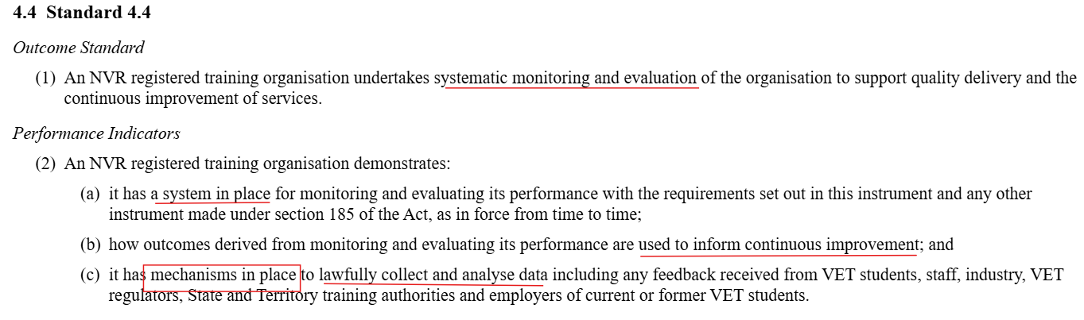
CONTINUOUS IMPROVEMENT

Slide 20
CONTINUOUS IMPROVEMENT
ANALYSING and IMPLEMENTING feedback and collated information.
SELF-ASSESSMENT internal and external benchmarks.
IDENTIFIABLE and DOCUMENTED systems.
EFFECTIVENESS of the feedback mechanisms (e.g. surveys).
REQUIRES
Continuous Improvement Policy and Procedure, Register or other tool.
A person responsible and accountable for the monitoring and reporting of Continuous Improvement across the organisation.

Slide 21
COMMON PITFALLS
TIPS
1
2
1
2
Not adjusting policies, when the size of an RTO has significantly grown (delaying administrative response times, and overpromising)
Not disclosing apparent conflicts of interest.
Encouraging an internal culture of feedback, support and action (continuous improvement)
A full risk assessment of the VET Provider also includes identifying areas of operation that affect the VET Provider’s ability to meet the Outcome Standards 2025.

Slide 22
SUMMARY
Understanding:
The function and elements of governance.
Who the ‘governing persons’, ’executive officers’ and ‘high managerial agents’ are within an RTO.
The difference between Fit and Proper Person and Suitable Persons.
The mechanisms that support an RTOs demonstration of leadership and accountability, risk management and continuous improvement.
The positive effect of roles and responsibilities at each level of the organisation and stakeholder relationships.

Slide 23
RESOURCES
National Vocational Education and Training Regulator Act 2011
National Vocational Education and Training Regulator (Outcome Standards for Registered Training Organisations) Instrument 2025
National Vocational Education and Training Regulator (Compliance Standards for NVR Registered Training Organisations and Fit and Proper Person Requirements) Instrument 2025
National Vocational Education and Training Regulator (Financial Viability Risk Assessment Requirements) Instrument 2021
National Vocational Education and Training Regulator (Data Provision Requirements) Instrument 2020
National VET Data Policy
ASQA Fit and Proper Person Declaration
Practice Guide - Leadership and accountability
Practice Guide - Fit and Proper Person Requirements
Practice Guide - Risk management
Practice Guide - Continuous improvement

Slide 24
QUESTIONS? LET’S CHAT!
THANK YOU
CONNECT WITH US
(07) 2113 3870​
hawkeyeconsultancy.com.au​
info@hawkeyeconsultancy.com.au

